Slide 1
Authentication for Web APIs using JSON Web Tokens and Passport
Frank Walsh, 2020

Slide 2

Agenda
JSON Web Tokens (JWT)
Authentication
Salting with BCrypt
Passport
Mongoose Middleware(hooks)
Use Case – Login/Register for React App using JWT/Passport

Slide 3
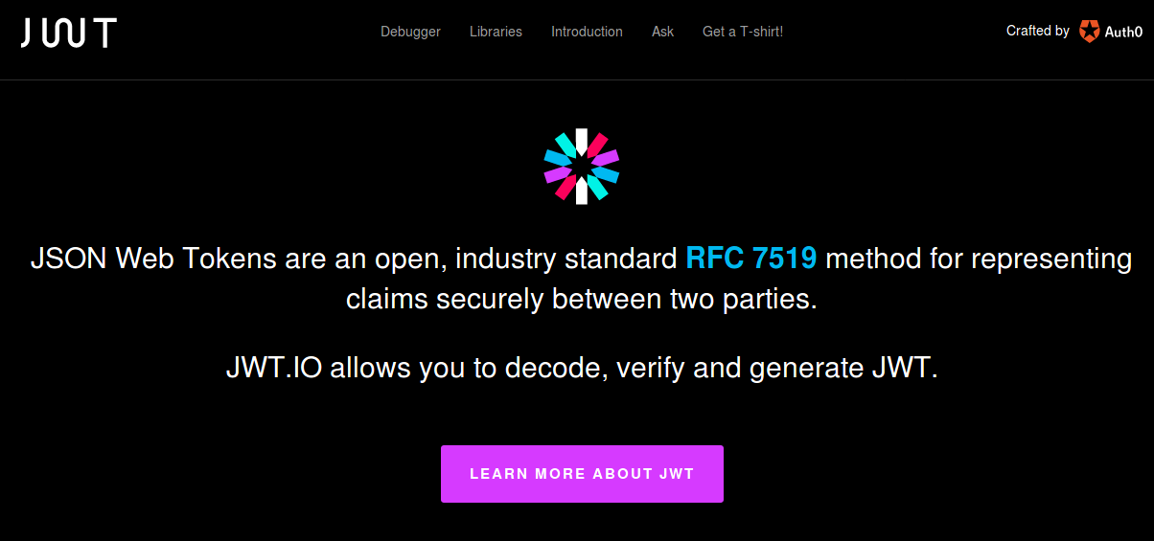
Authentication options
Many solutions for Auth
Cookies, basic-auth, JWT, Oauth.
Web-based Identity Federation/3rd Party (Firebase)
JSON Web Tokens (JWT)
Tokens means no need to keep sessions or cookies
In keeping with REST stateless principle – token sent on each request
Token stored on client, usually in local storage of client.
Notes:
OAuth (Open Authorization) is an open standard for token-based authentication and authorization on the Internet.
Cookie authentication uses HTTP cookies toauthenticate client requests and maintain session information.
In basic HTTP authentication, a request contains a header field of the form Authorization: Basic <credentials>, where credentials is the base64 encoding of id and password joined by a colon.

Slide 4
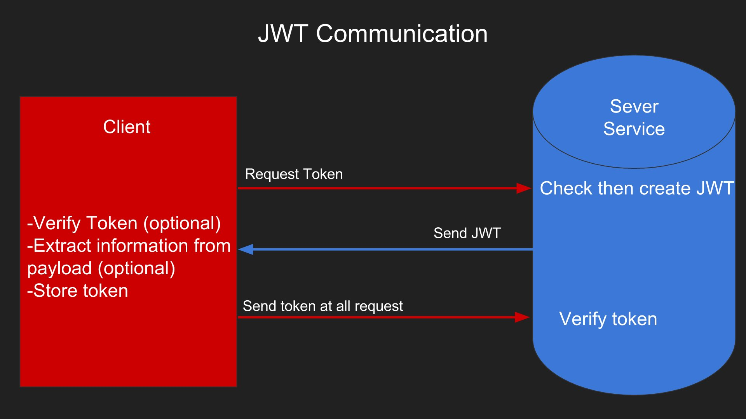
JSON Web Tokens
Notes:
defines a compact and self-contained way for securely transmitting information between parties as a JSON object.
information can be verified and trusted because it is digitally signed.
Once the user is logged in, each subsequent request will include the JWT, allowing the user to access routes, services, and resources that are permitted with that token. Single Sign On is a feature that widely uses JWT nowadays, because of its small overhead and its ability to be easily used across different domains.

Slide 5
Username and Password Scenario
Scenario
User signs up to access an API (username & password)
Create a new user in database
Use new username to create a JWT
Send JWT back to user
User stores JWT
JWT used on every subsequent request to protected resource
Authentication and Identification
...because username was used to generate JWT.

Slide 6
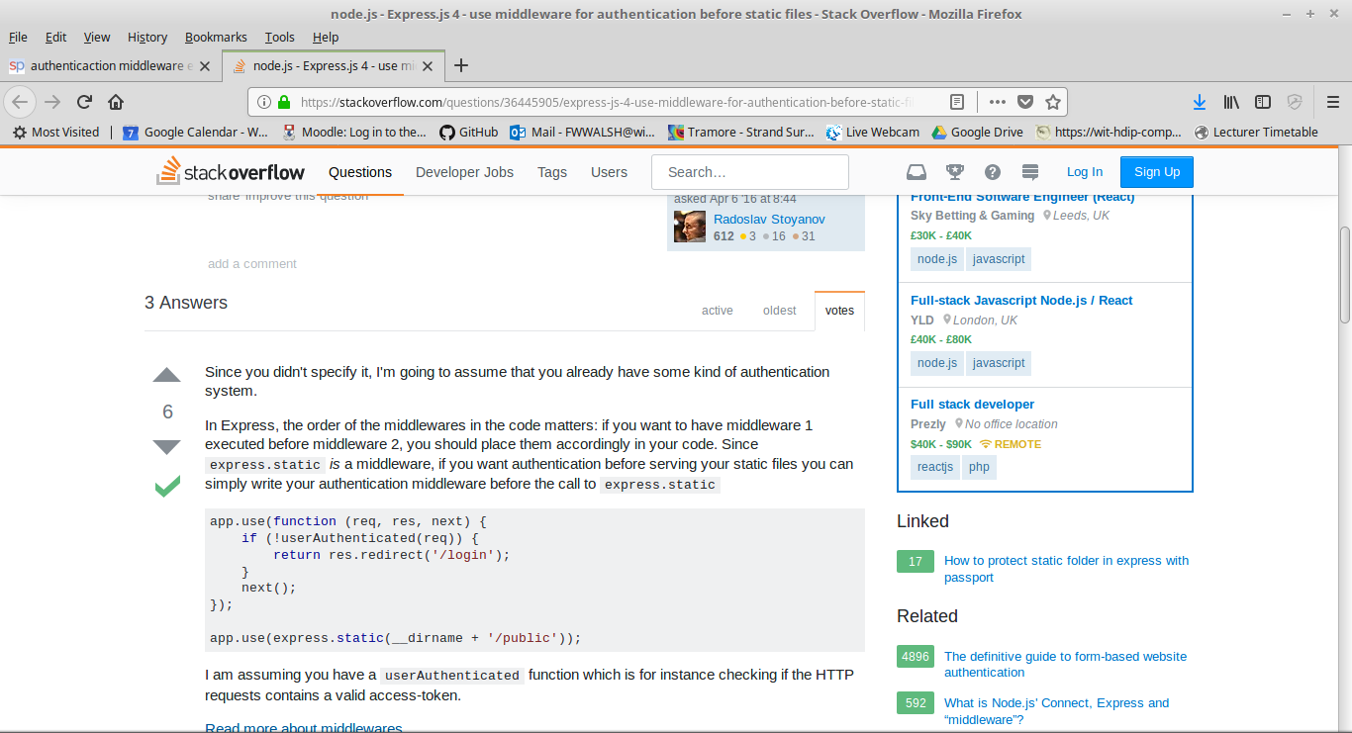
Authentication Middleware
Need express middleware to manage user login
Need Express middleware to restrict access to sensitive routes.
Options
Roll our own(Like last week…)
Use existing framework/package

Slide 7

Passport
Passport is authentication middleware
Flexible and modular.
Easy to retrospectively drop in to an Express app.
Lots of "strategies" for authentication
Username/Password
Facebook
Twitter

Slide 8
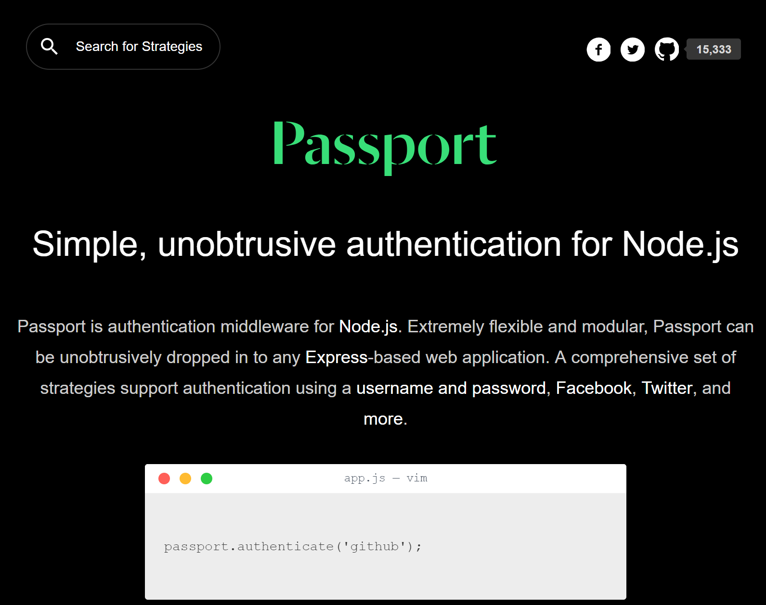

Slide 9
Passport Overview
Passport offers different authentication mechanisms as Strategies
You install just the modules you require for a particular strategy
Authenticate by calling passport.authenticate()
specify which strategy to use.
The authenticate() function signature is a standard Express middleware function…
Just drop it in..

Slide 10
Authentication for MovieDB
Restrict access to authenticated users.
Provide User API to login/register.
Users should only have to log in once:
Ideally identified and authenticated in subsequent requests.
Username and Password authentication.
No clear case passwords like last week!!!
Hash/Salt all passwords in MongDB

Slide 11
Web authentication – credentials
Credentials should be stored securely in a centralised location
Should only be readable by suitably privileged users
Credentials should not find their way into hidden fields, headers, cookies
Should not be “hard coded”
Passwords should be “salted” and “hashed”
Salting involves appending random bits to each password
Salted password is then hashed (i.e. one-way encrypted) for storage
Objective is to store something derived from the password that allows an entered candidate password to be checked …
… but such that the password cannot be retrieved (by anybody, even an administrator)

Slide 12
Passwords & Salting
Password Creation
Password Verification
Plain Text Password
Salt
Plain Text Password
Hashing function
Hashing function
Hash
Do They Match?
Stored Credentials
Stored Credentials
Salt
Hash
Salt
Hash

Slide 13

Why Salt?
Frustrates dictionary attacks.
Prevents duplicate passwords appearing as duplicates in password db (using different Salts)
Protects users where same password is reused on different systems/sites.
This Photo by Unknown Author is licensed under CC BY-SA

Slide 14
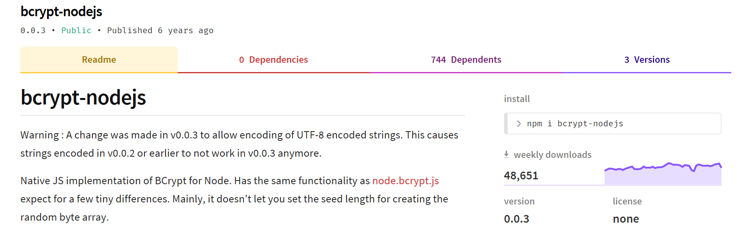
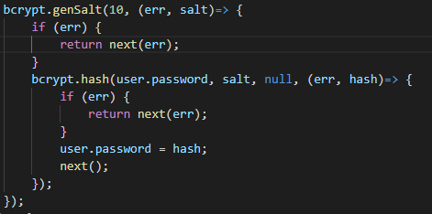
Salting and Encrypting in Node.js/Express
Several NPM packages available.
Also in other languages (Java)

Slide 15
Encrypting - Mongoose User Model

Slide 16
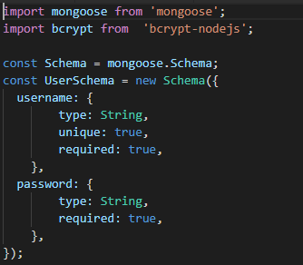
Create Mongoose User Model
Use Mongoose to specify user model:

Slide 17
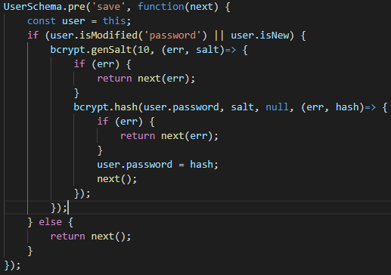
Mongoose Middleware: Hash/Salt Passwords
Mongoose supports Middleware (also called pre and post hooks).
Can use, like Express middleware, to process documents
Use bcrypt package to hash and salt passwords

Slide 18
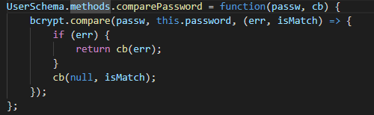
Mongoose Methods: compare passwords
You can define instance and static methods in Mongoose Schemas.
For authentication, define a comparePassword(..) instance method
Use this to authenticate users
Bcrypt used to compare with hashed/salted password.

Slide 19
User API: User Routes
Create new router to support following API
Route | GET | POST | PUT | DELETE
/api/users | List all users | Register/ Authenticate User | N/A | N/A

Slide 20
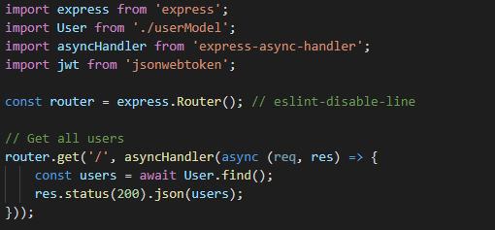
User API: Get users
Create a route to list all users:

Slide 21
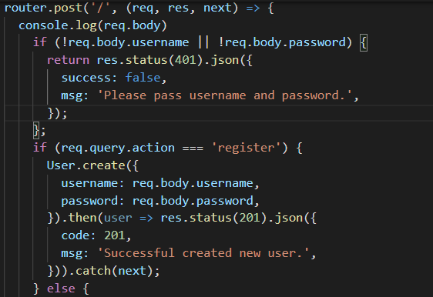
User API: Register new user
Will use query string of URL to indicate action to take on resource
Action===register will register new user
http://localhost:8080/api/users?action=register

Slide 22
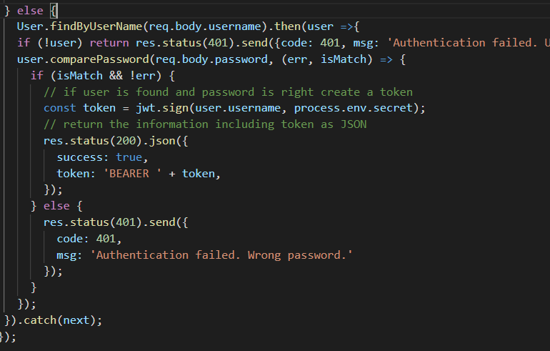
User API: Authenticate User
Find user and compare password using user model
Generate and return JWT token using username field
Client needs to keep token for subsequent messaging
store JWT in local storage.

Slide 23
Users API: User Collection
Users Collection
_id | "5ad46fccada1ab2d67b349ec"
username | "user1"
password | "$2a$10$9r3v12AvPPSkcpJXiohGgehGY50gvgWFV9AAABi37caggsPmxBdwW"
__v | 0
1
_id | "5ad46fccada1ab2d67b349ed"
username | "user2"
password | "$2a$10$YZlmbnUSZhBq9FAsAqKTyOJk8uXEweC7XtTNY/ozu8aMGXDW07Xxa"
__v | 0
Hashed/Salted value for password "test1"

Slide 24
Protecting Routes with Passport

Slide 25
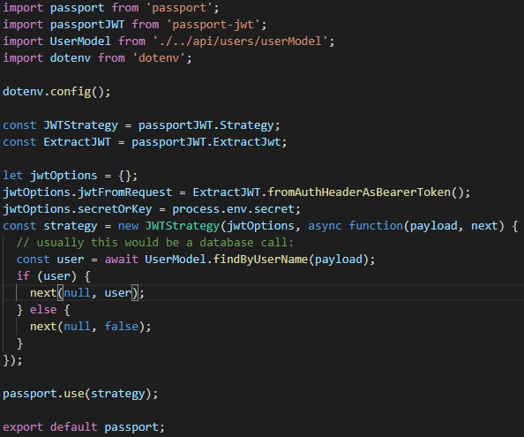
Protecting API Routes: Passport JWT Policy
/auth/index.js
Passport strategies are a middleware functions that a requests runs through before getting to the actual route.
If the authentication strategy fails,
callback will be called with an error
the route will not be called and a 401 Unauthorized response will be sent.

Slide 26

Protecting API Routes: initialise and add Middleware
In /index.js of express app
// import passport configured with JWT strategy
…
// initialise passport
// Add passport.authenticate(..) to middleware stack for protected routes

Slide 27
React Apps and JWT

Slide 28
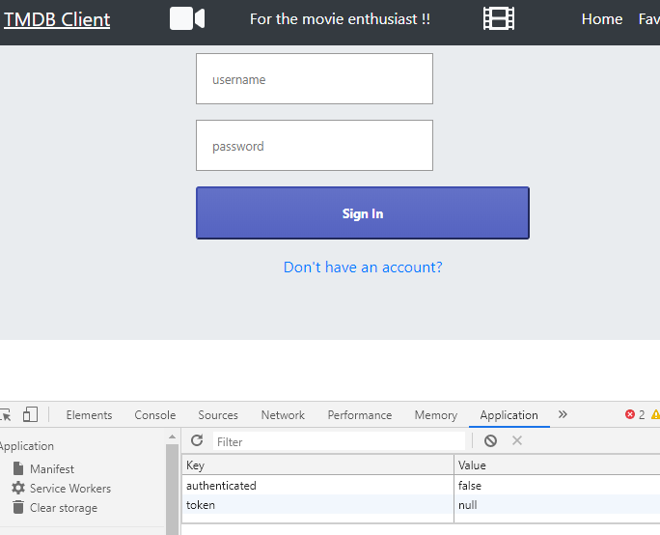
MovieDB App
We want to:
Replace with calls to MovieDB API
Provide login/signin capabilities.
Only allow signed in users to see Movies and add stuff

Slide 29
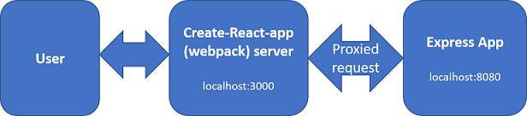
Proposed Architecture
Create-React-app uses Webpack development server.
MovieDB API is an Express.js app.
Configure Webpack server to "proxy" any unknown requests to Express app
Just need "proxy":"http://localhost:8080" entry in package.json.
Removes Cross-Origin-Resource-Sharing (CORS) issues with the browser

Slide 30
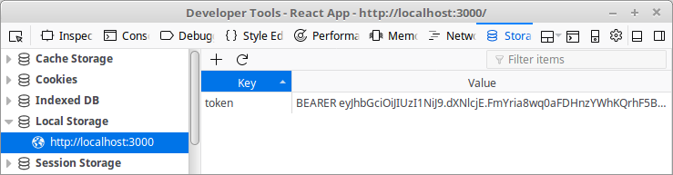
JavaWebToken Storage
Most browsers/devices have local storage .Can access using localStorage object.
localStorage.setItem('token', token);
const token = localStorage.getItem('token');

Slide 31
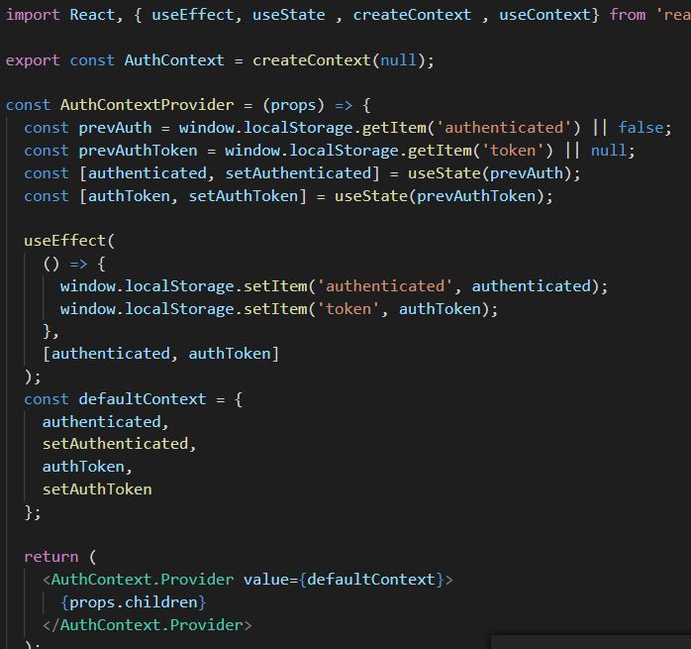
Contexts
Create a Authentication Context in MovieDB React App.
As with Movie and Genre contexts, use it to pass data through the component tree
Share authentication details between components

Slide 32
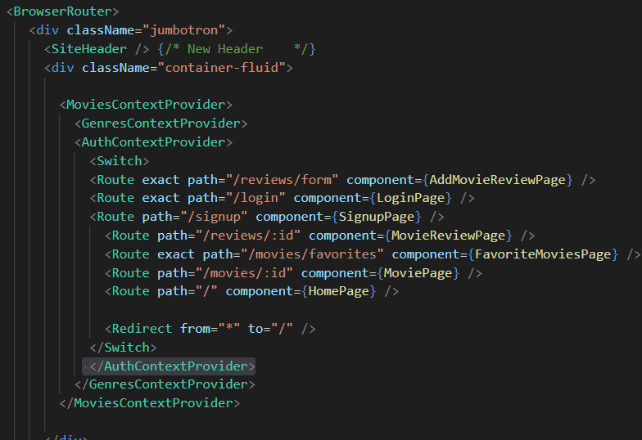
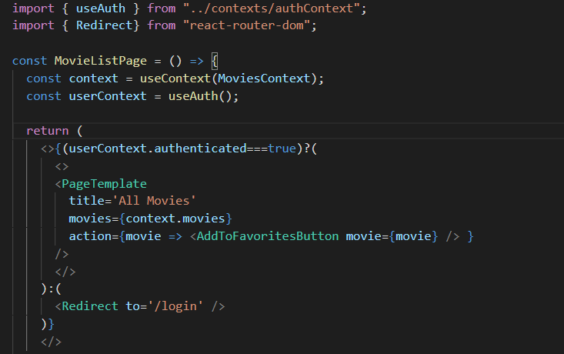
Use Context Provider in React App
Import context and use it to check authentication status

Slide 33
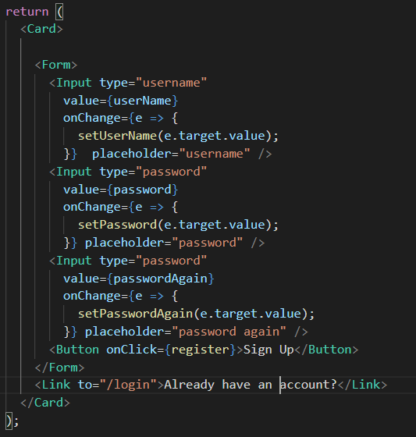
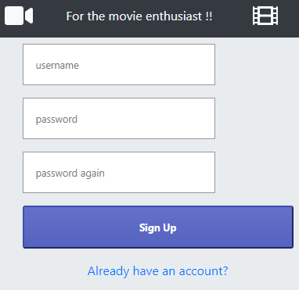

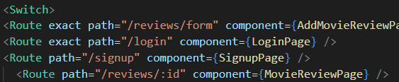
Login/Register Component
Add to App router (in index.js)

Slide 34
Summary
Create User model with Mongoose
Pre-save hook to salt/hash passwords
Instance method to compare passwords
Implement user API to authenticate/signup users
Sign JWT tokens with user name
Add a JWT Strategy to Passport.js
Use passport.authenticate(…) to secure server-side routes
Add to middleware stack.

